Slide 1

Smart Delivery Dashboard: Frontend Architecture
A technical deep-dive into the frontend implementation of our delivery management platform, showcasing modern React architecture and scalable design patterns.

Slide 2

Core Technology Stack
React.js
HTML5 & CSS3
Component-based architecture enabling fast UI rendering and efficient state management
Modern markup with Flexbox and Grid for responsive, structured layouts
JavaScript ES6+
React Router
Modern syntax for logic, events, and dynamic content updates
Seamless multi-page navigation without page reloads
This technology stack ensures rapid development cycles, clean UI handling, and a maintainable codebase that scales with business needs.

Slide 3
React Architecture & Project Structure
The application follows React's component-driven structure to maximize reusability and maintain code clarity. Our folder organization separates concerns and improves developer efficiency.
src/
├── components/
│ ├── Sidebar
│ ├── Navbar
│ ├── Cards
│ └── Tables
├── pages/
│ ├── Dashboard
│ ├── Orders
│ ├── Drivers
│ └── Login
├── utils/
├── App.js
└── index.js
Key Structural Benefits
Clear separation between UI components and page logic
Reusable components across multiple views
Easy onboarding for new developers
Simplified testing and maintenance

Slide 4
React Concepts in Action
useState Hook
Props System
useEffect Hook
Manages component-level state for interactive UI elements
Enables seamless data passing between parent and child components
Executes side effects when components mount or update
Conditional Rendering
Component Reusability
Creates dynamic UI that responds to application state
Cards, tables, and layouts deployed across multiple pages

Slide 5

Navigation with React Router
Route Configuration
Key Benefits
Zero page reloads — instant navigation between views
/login
Fast performance — single-page app architecture
User authentication entry point
Clean URLs — bookmarkable routes for each section
Easy maintenance — route-specific components stay organized
/dashboard
Main analytics and overview
/orders
Complete order management
/drivers
Driver status and assignments

Slide 6
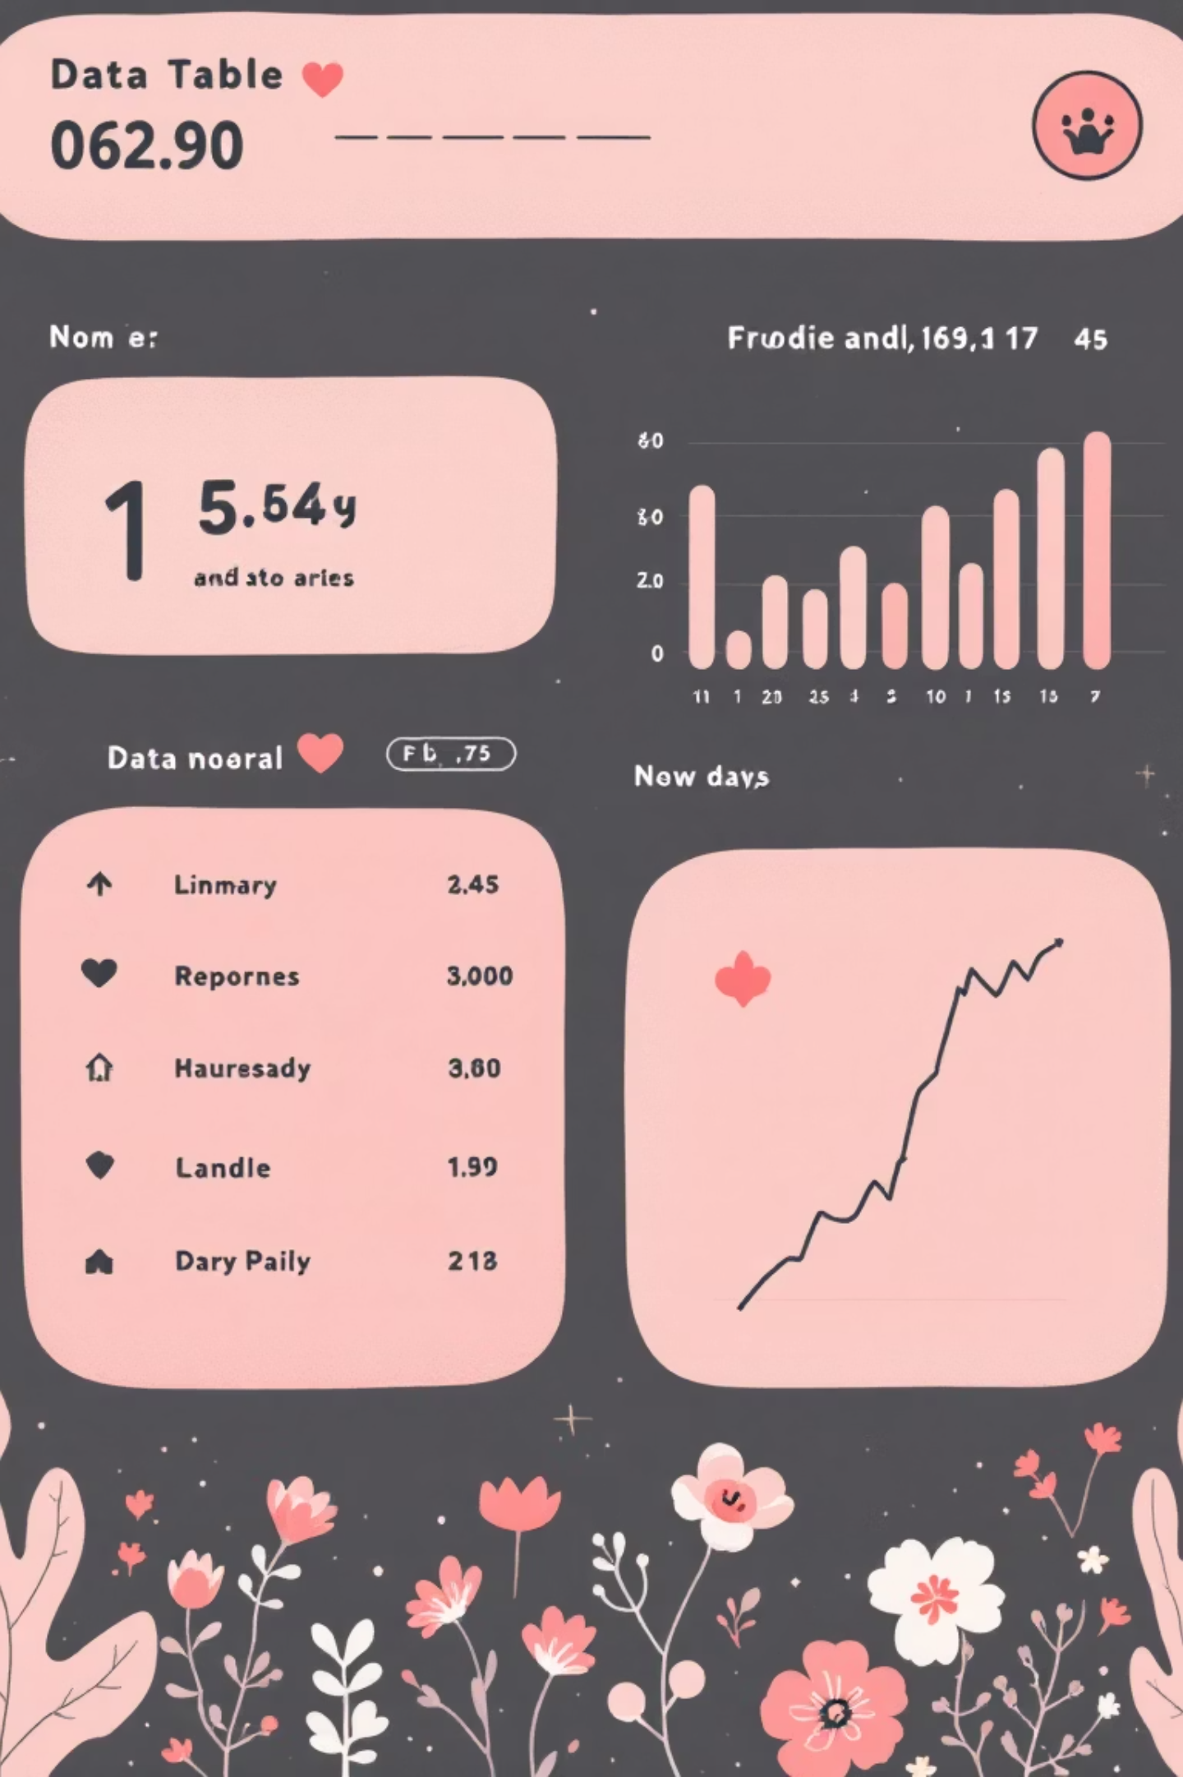




Orders Page: Technical Implementation
The Orders Page displays a comprehensive list of all delivery orders with real-time status updates and customer information.
Data Source
Array of order objects with structured fields
Dynamic Rendering
Table rows generated using .map() function
Conditional Styling
Status colors applied based on order state
Modular Design
Separate components for table rows
This architecture ensures data integrity while maintaining a clean, scannable interface for operations teams.

Slide 7


Drivers Page: Component Reusability
Core Features
Comprehensive driver details table (Name, Status, Phone)
Real-time status indicators with color-coded styling
Add/modify driver functionality
Reusable table component architecture
Design Pattern: The Drivers Page demonstrates our commitment to component reuse — the same table structure used in Orders is adapted here with different data props.
State Management
Driver status updates trigger re-renders only for affected components, optimizing performance and maintaining UI responsiveness across the application.

Slide 8
Code Architecture: State & Event Handling
React's declarative approach simplifies user input management and UI updates. Here's how we handle authentication state:
const [email, setEmail] = useState("");
const [password, setPassword] = useState("");
const handleLogin = () => {
console.log("Email:", email);
console.log("Password:", password);
};
State Initialization
State Update
useState creates reactive variables
setState functions trigger re-render
1
2
3
4
User Input
Action Handler
Input fields bind to state values
Event processes updated state
This pattern ensures the UI always reflects the current application state, creating a smooth and predictable user experience.

Slide 9
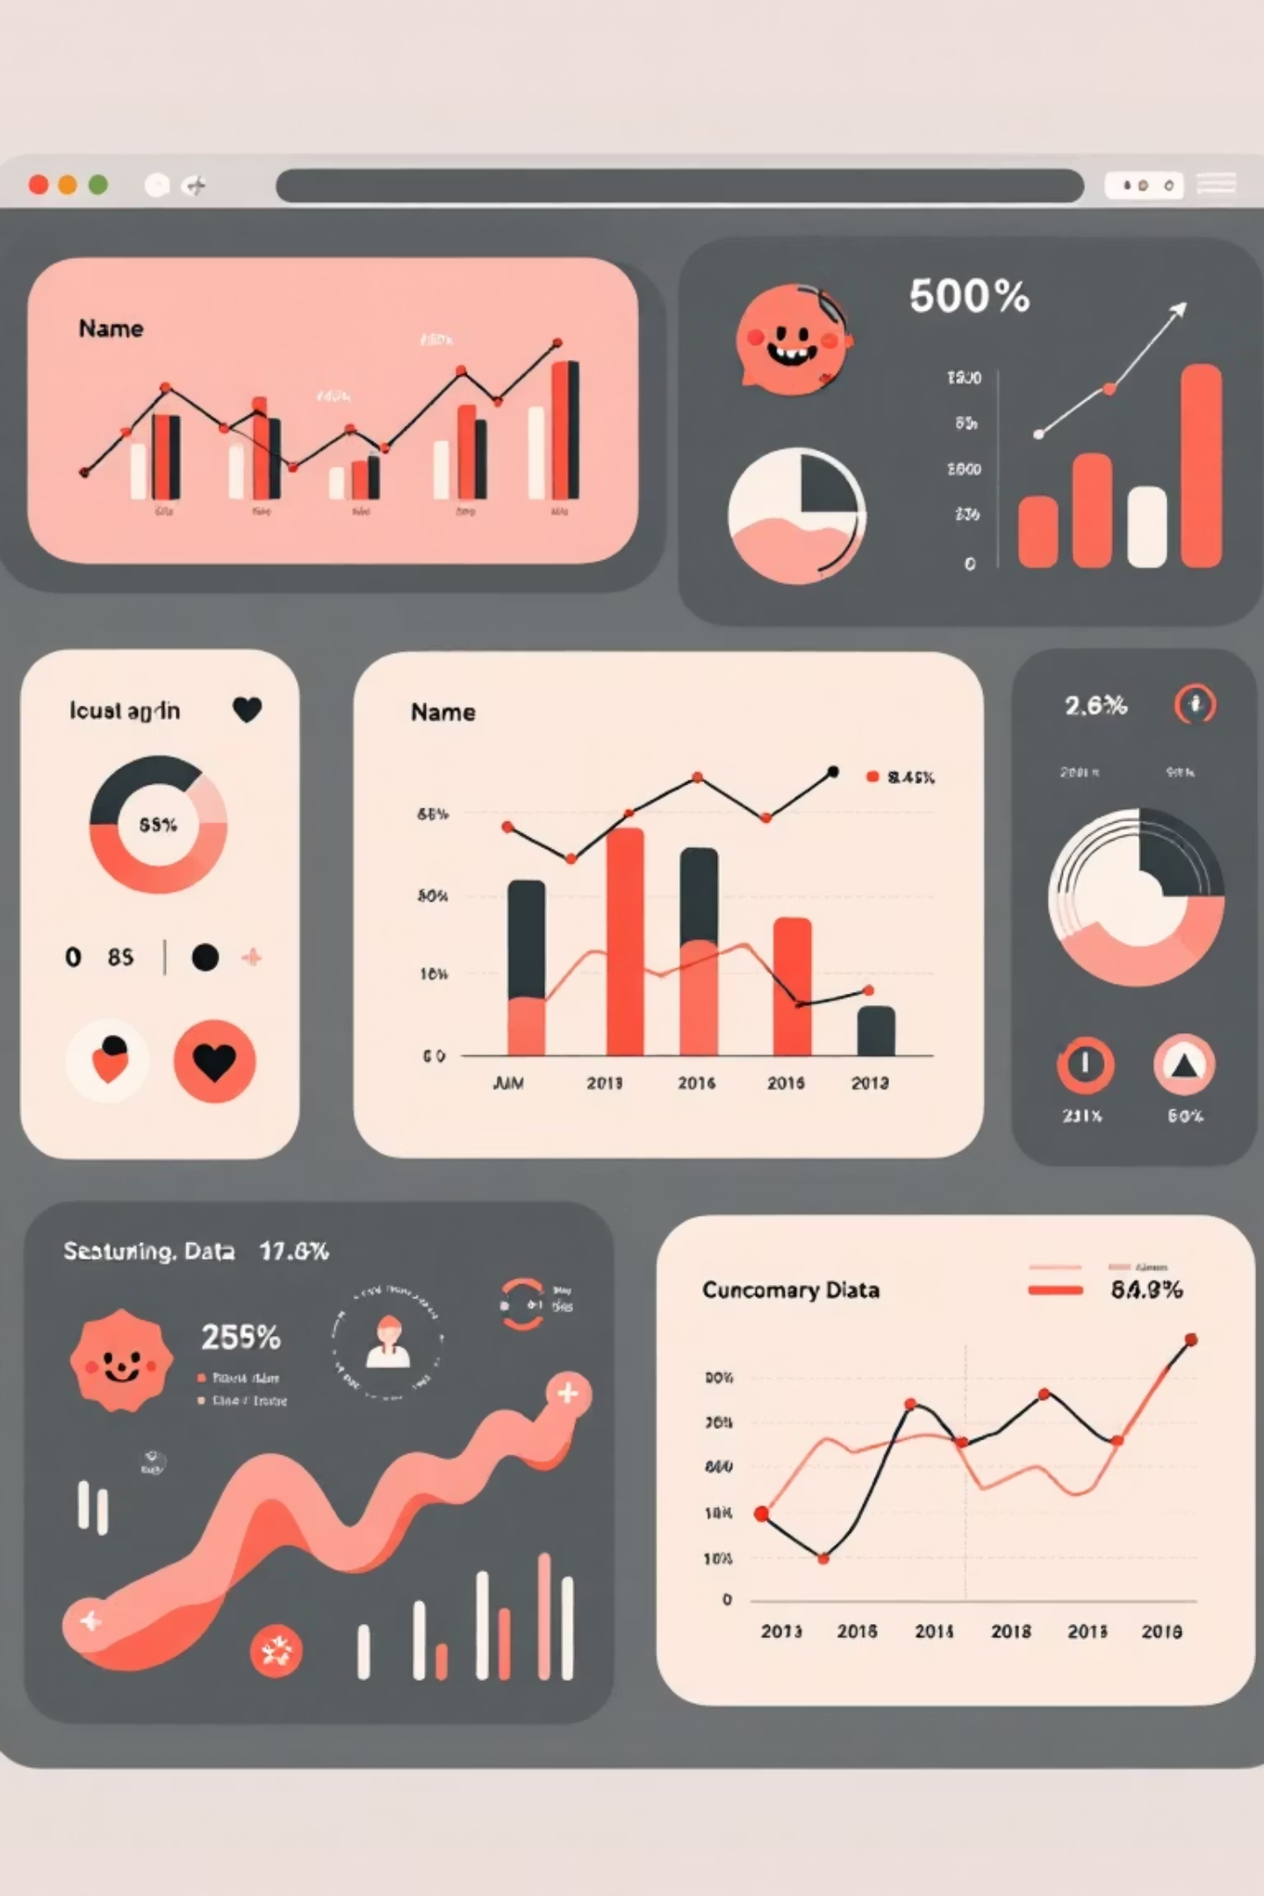
Dynamic List Rendering
The Power of .map()
{orders.map((order, index) => (
<tr key={index}>
<td>{order.orderCode}</td>
<td>{order.customer}</td>
<td>{order.status}</td>
<td>{order.eta}</td>
</tr>
))}
Orders and drivers tables leverage JavaScript's .map() method to dynamically generate table rows from data arrays.
Benefits of This Approach
Automatic updates when data changes
Key insight: Each row receives a unique key prop, enabling React to efficiently track and update individual elements.
No manual DOM manipulation
Scales effortlessly with data size
Clean, readable code structure

Slide 10

Results & Future Vision
Technical Achievements
Future Enhancements
100%
4
Backend Integration — Connect to REST API for live data
Advanced Features — Search, filter, and sort capabilities
Component Reusability
Core Pages
Form Validation — Client-side input verification
Dark Mode — User preference theming
All UI elements modular and reusable
Login, Dashboard, Orders, Drivers
Animations — Smooth transitions and micro-interactions
State Management — Redux integration for complex data flows
0
Page Reloads
Seamless SPA navigation
"This implementation demonstrates strong command of React fundamentals and professional UI development practices."

